Slide 1
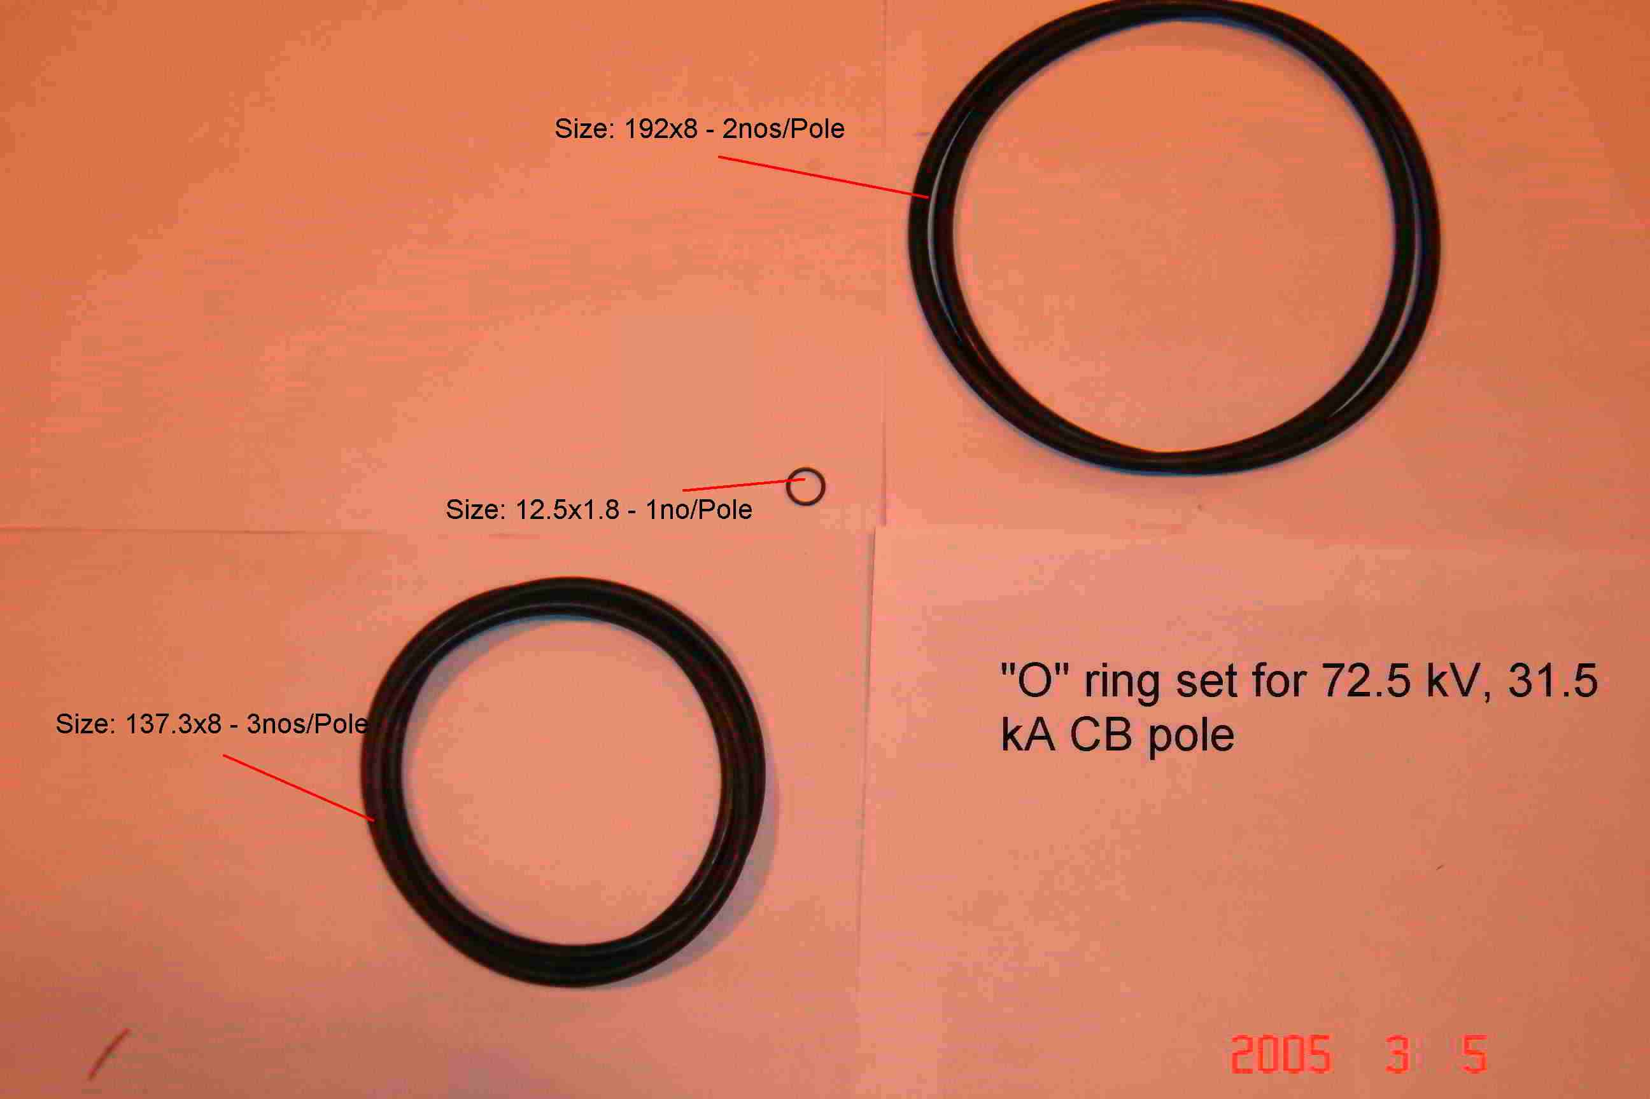
SIEMENS
HVCB SPARES
“O” rings set for each pole for 72.5KV, 31.5KA CB
S4799244001

